Slide 1
Sales Analysis 360 Project
Prepared By : Akash deep
End-to-End Sales Analytics

Slide 2
Project Overview
Comprehensive sales analytics solution covering:
- Revenue & profitability
- Customer behaviour
- Product & category trends
- Store, city & region performance
Data extracted using SQL and analysed using Python (EDA).

Slide 3
Objectives
- Understand sales performance across products & regions
- Identify growth opportunities & inefficiencies
- Analyze customer purchasing & return behavior
- Support data-driven business decisions
Highlight customer purchase patterns.

Slide 4
Tools & Technologies
- SQL (Data Extraction)
- Python (Pandas, NumPy)
- Matplotlib & Seaborn (Visualization)
- Jupyter Notebook (EDA)
- PowerPoint (Insights Presentation)

Slide 5
Data Sources
Orders
Product Master
Customer Master
Store Master
Returns.

Slide 6
2.KPIs: Sales, Margin%, GMV, AOV, Units Sold, Repeat Rate, Return Rate
Total Sales: 108803550.87
Total GMV: 128004177.66000001
Units Sold: 50235
AOV: 5440.1775435
Margin %: -15.47
Repeat Rate %: 92.60
Return Rate %: 7.47

Slide 7
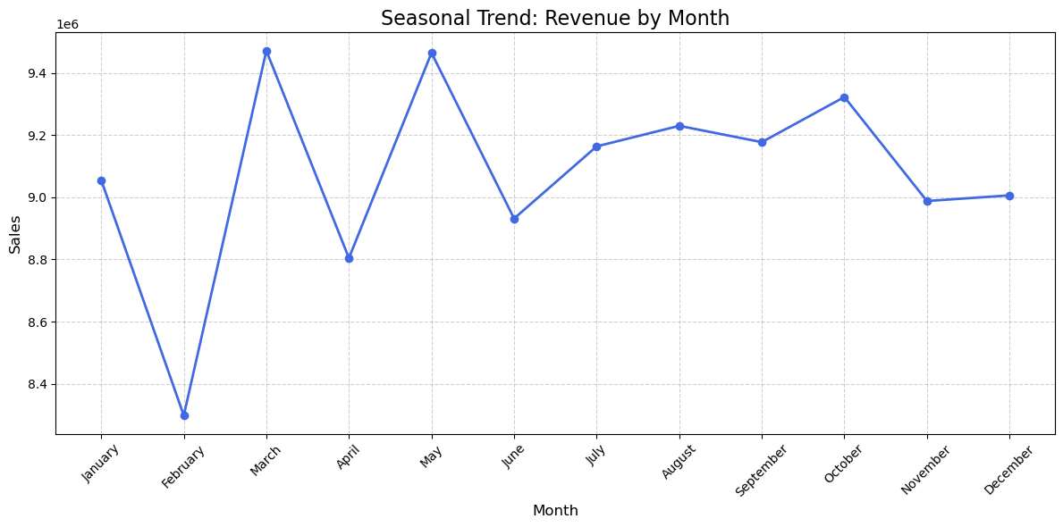
Seasonal Trend: Revenue by Month:
January 9055508.48 February 8298269.92 March 9471519.30
April 8804584.72 May 9464628.24 June 8931666.70
July 9163736.81 August 9229816.43 September 9177392.63
October 9322530.67 November 8987982.99 December 9006213.03

Slide 8
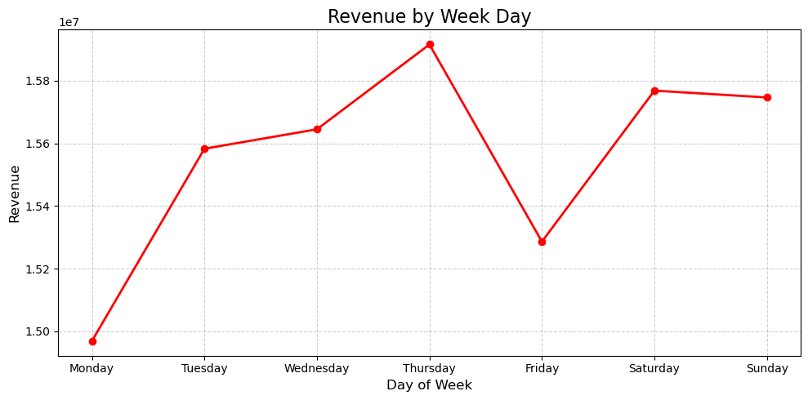
Seasonal Trend: Revenue by Week Day :
Revenue peaks on weekends and mid-week, particularly on Wednesdays and Thursdays, reflecting increased consumer engagement and buying behavior

Slide 9
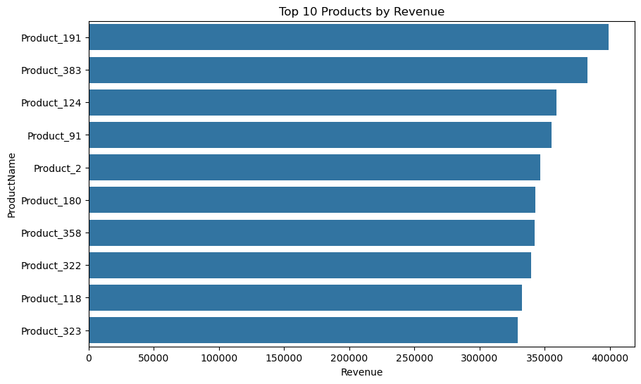
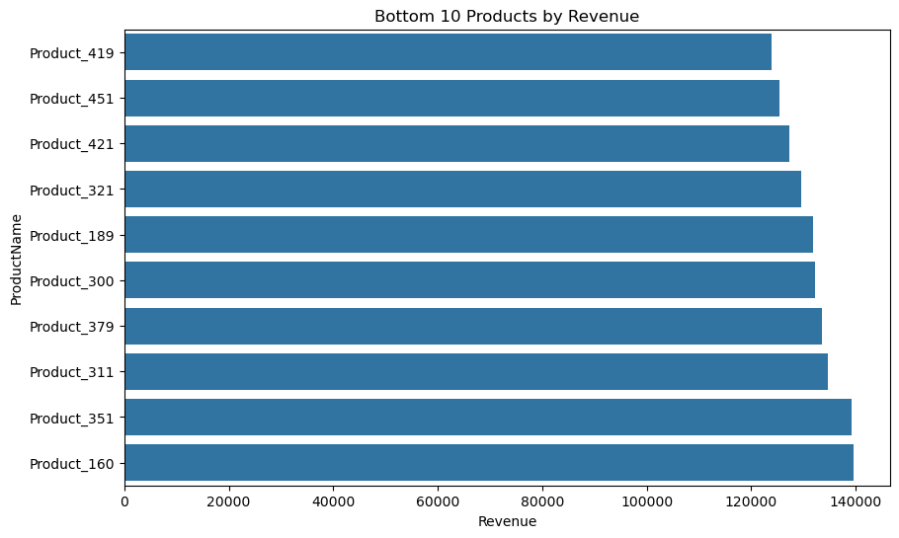
Business Requirement:
Evaluating top and bottom SKUs provides actionable insights to maximize inventory efficiency, strengthen marketing focus, and drive product innovation.
Product_191, Product_383, and Product_124 consistently outperform other SKUs, reflecting strong customer demand and market acceptance.
Immediate action is required for bottom-performing products to improve performance through repricing, repositioning, or discontinuation

Slide 10
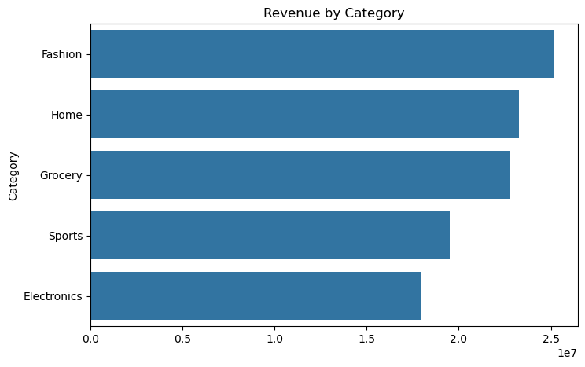
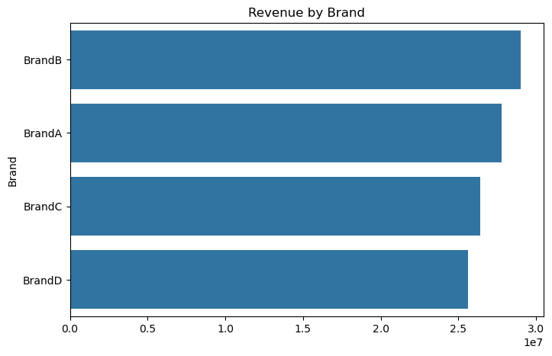
Category-wise Revenue
Fashion categories show strong performance, whereas the electronics category underperforms and warrants detailed root-cause analysis
Brand – Wise Revenue : Brand B demonstrates strong revenue performance, whereas Brand D lags behind Brand A and requires in-depth root-cause analysis to identify improvement opportunities

Slide 11
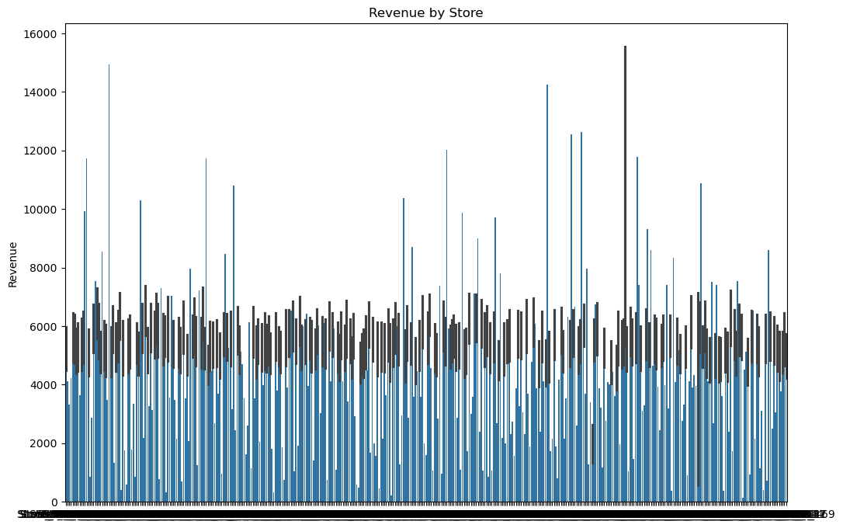
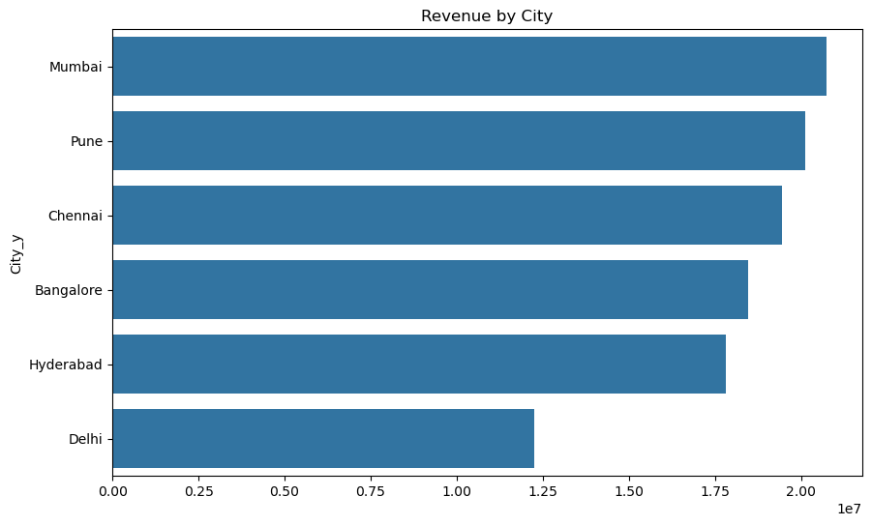
Store & Region Analysis :
The consistent strong performance of Store_18, Store_145, and Store_3 highlights their critical role in driving overall business revenue.
City – Wise Revenue :
The strong revenue performance of Mumbai and Pune contrasts with Delhi’s underperformance, highlighting the need to analyze customer behavior and regional drivers in Delhi.

Slide 12
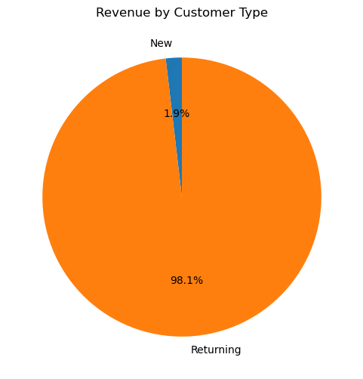
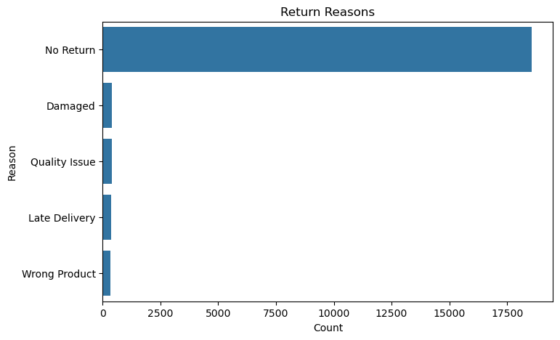
Customer Insights & Return Analysis :
Returning customers typically generate higher revenue because they have greater trust in the brand, are familiar with the products, and respond more effectively to marketing efforts. Their purchasing behavior is more consistent and frequent. In contrast, new customers are still exploring options, which results in lower initial purchase frequency and spending.
Return Reason:
Improve product quality
Update descriptions and sizing info
Reduce shipping issues
Target customer satisfaction initiatives

Slide 13
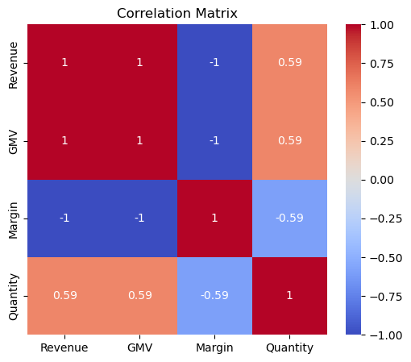
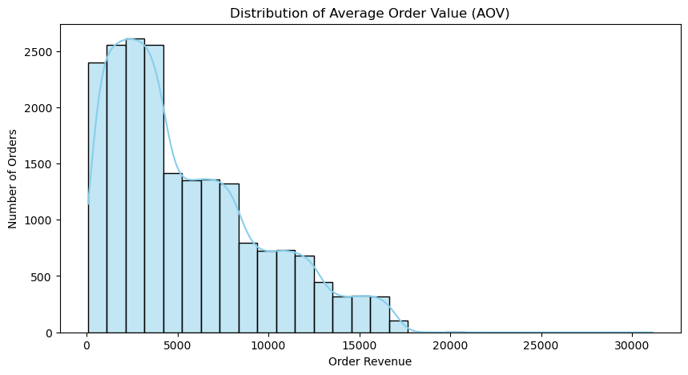
Correlation Analysis :
EDA Analysis :
AOV Distribution :

Slide 14
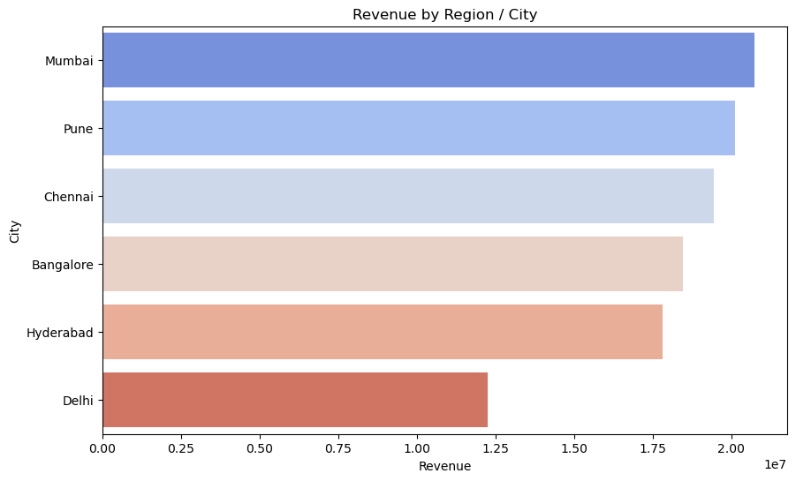
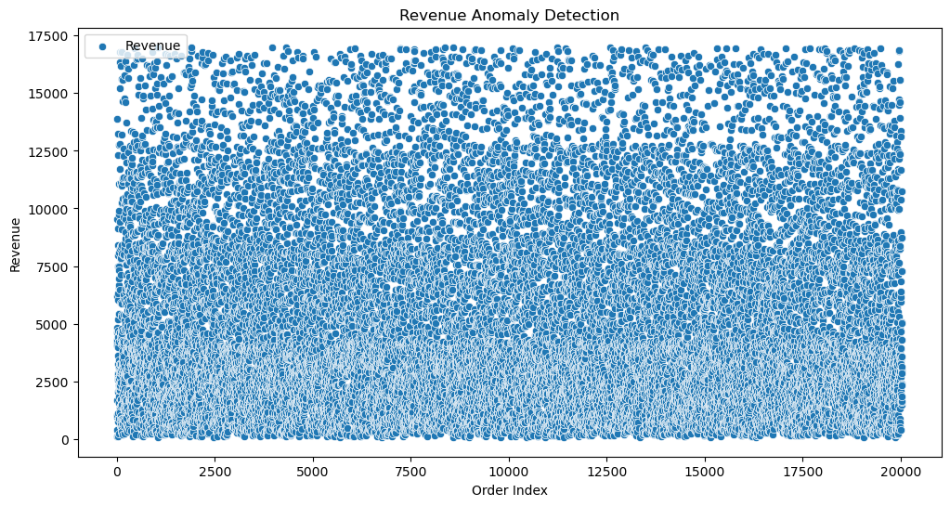
Region Revenue Heatmap (Bar Chart) :
Visualize anomalies :

Slide 15
Recommendations
Prioritize inventory planning and marketing efforts for top-performing products and SKUs.
Increase stock levels for high-demand items to prevent lost sales.
Allocate higher marketing budgets to strong-performing regions while launching targeted campaigns in low-performing regions.
Focus on retaining high-value and repeat customers through loyalty and engagement programs.
Reduce product returns by improving quality checks, enhancing product descriptions, and offering better-matched promotions.
Limit excessive discounts on low-margin items to protect overall profitability.
Improve visibility of high-margin but low-sales products through strategic promotions.
Prepare inventory and staffing in advance for peak seasonal demand.
Enhance overall customer experience through faster delivery and improved customer support.

Slide 16


